Slide 1
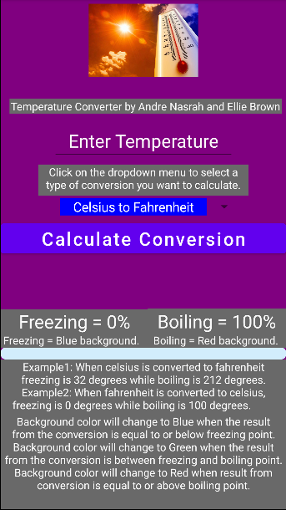
Temperature Converter created in Java/Android Studio
By Andre Nasrah and Ellie Brown

Slide 2
Final Project description - What you built your code
Temperature Converter built with Java/Android Studio.
I would say code is close to 100% as there some minor bugs with Kelvin as it is an absolute temperature scale.
Photos provided in presentation as well as live demo.
Code organization explained – ConverterClass.Java, MainActivity.java, activity_main.xml, AndroidManifest.xml, custom_progress_bg.xml (created within drawable directory,) and associated image.
The project relies on activities within MainActivity.java utilizing the ConverterClass.java to create new objects for each conversion as well as the layout files such as activity_main.xml and custom_progress_bg.xml as part of the progress bar.
No design patterns were purposefully used with the project.
Completion level - Working 50%, 75%, or 100%, or not working
Demonstration or demonstration pictures (still or moving)
Software code structure - Organization of classes and objects
The project complexity
Use of design patterns if any

Slide 3
Software code testing - how you tested your code
We have 24 test cases, 4 for each of the 6 associated temperature conversions. Also tested against existing online conversion calculators to test consistency.
Layout needs constantly be updated /resolved with new features being added. Not necessarily the same per device as sequence of design / implementation could be different on each machine that is developing the application.
Andre Nasrah contributed conceptual – stripped down code before as well implementing converterclass.java to have a class object associated with program, basic layout in activity_main.xml, and basis of documentation. Contributed to Github regarding bug editing. Provided test cases along with updates which were regularly pushed to Github. Zoom meeting setups and coordination of meetings.
Ellie Brown contributed development of additional features such as progress bar/ if/else statements with background changes, spinner/ dropdown menu, implementation of Kelvin associated conversions being integrated with her newly modified of her previous implementations of Fahrenheit/Celsius. Contributed to Github regularly. Created README.md file with original contents.
Challenges and/or the project complexity
Individual contributions

Slide 4

Temperature Converter Application Overview
User inputs a number (temperature) and selects if they want to convert from Celsius to Fahrenheit, Fahrenheit to Celsius, Kelvin to Fahrenheit, Fahrenheit to Kelvin, Celsius to Kelvin, or Kelvin to Celsius.
A progress bar is implemented at the bottom of the screen to indicate freezing, and boiling based on conversion. When the bar is at 0% it means that value was either at freezing or below freezing. When the bar is full it means that value was either at boiling point or above it.
For example, when a user inputs 32 and selects to convert from Fahrenheit to Celsius, the bar will be at 0 and the result will be 0 in the output field. This indicates that 32 F and 0 C are the same both visually and numerically.

Slide 5

How to Use
Click on the input field and type in a number (temperature) you wish to convert.
Select which conversion you want to do by clicking on the dropdown menu just below the text input field and choose between either Celsius to Fahrenheit, Fahrenheit to Celsius, Kelvin to Fahrenheit, Fahrenheit to Kelvin, Celsius to Kelvin, or Kelvin to Celsius.
Click on the Calculate Conversion button just below the dropdown menu. The resulting conversion will appear in the output field below the buttons.
Disclaimers are present towards the bottom of the application to further help the user understand how the visual aids work.

Slide 6
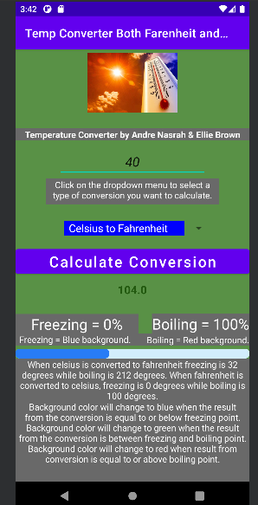
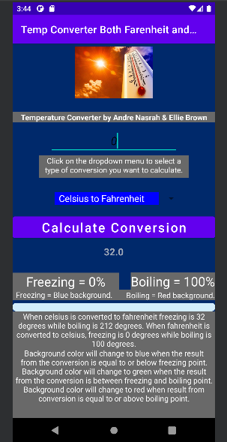
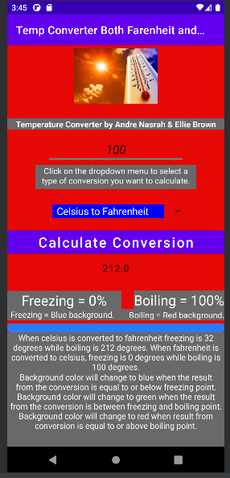
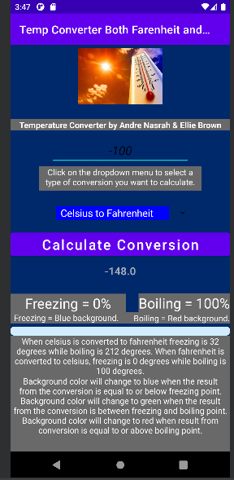
Visual Aids
Background of application will change based on how the converted output (temperature) falls within, or close to the freezing or boiling point.
Freezing temperatures will have a blue background. (At or below freezing point)
Boiling temperatures will have a red background. (At or above boiling point)
Temperatures between freezing and boiling will have a green background.

Slide 7
Visual Aids Cont.
A progress bar shows how close the converted number is close to either freezing or boiling point.
Freezing temperatures will be shown as 0% on the progress bar. (At or below freezing point)
Boiling temperatures will be shown as 100% on the progress bar. (At or above boiling point)
Temperatures between freezing and boiling will be shown as their respective closeness to freezing or boiling.

Slide 8


Dropdown Menu Implementation
To make selecting a conversion easier we implemented a dropdown menu which houses the 6 different types of conversions to choose from.
Users can choose from: Celsius to Fahrenheit, Fahrenheit to Celsius, Kelvin to Fahrenheit, Fahrenheit to Kelvin, Celsius to Kelvin, or Kelvin to Celsius.
Notes:
Implemented by Ellie

Slide 9

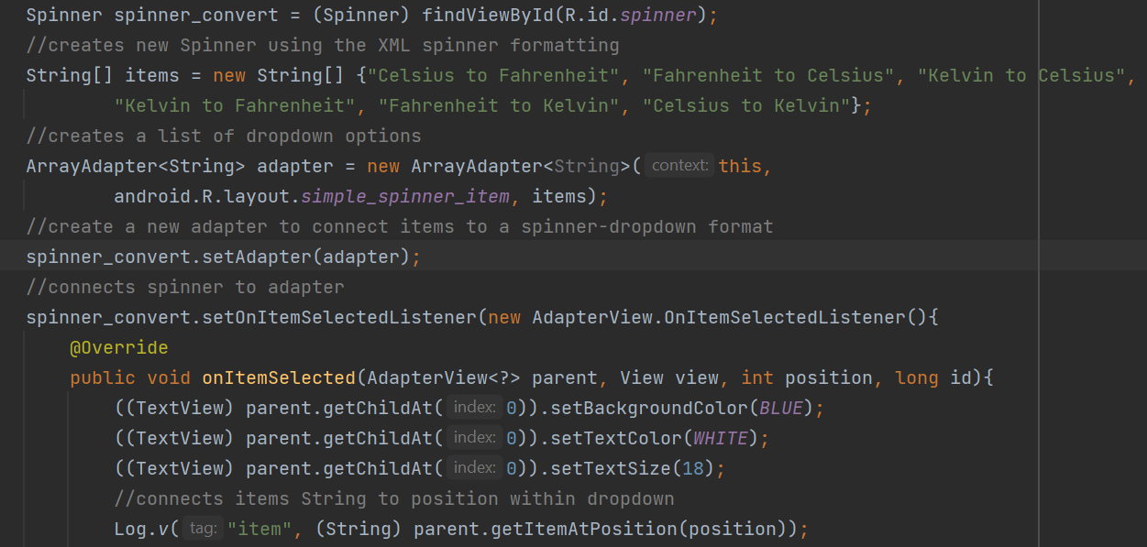
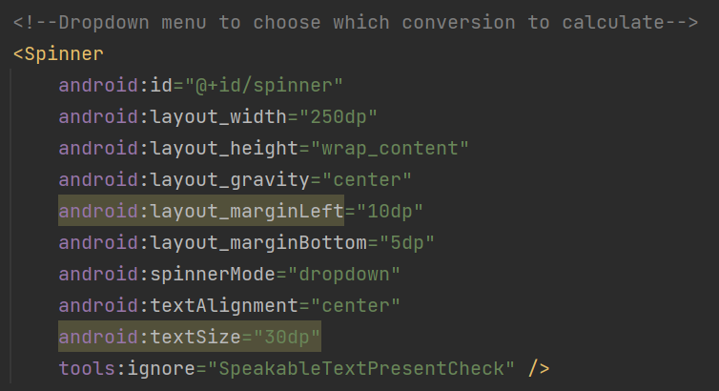
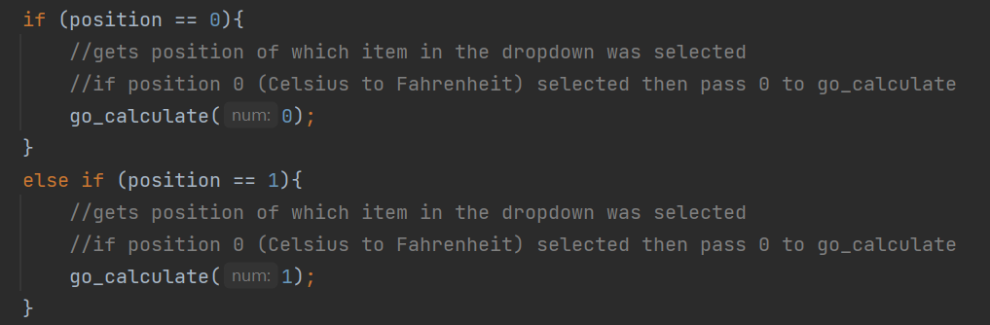
Dropdown Menu Code

Slide 10
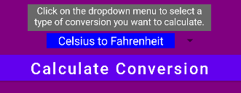
Conversion Button Implementation
Originally, we has two buttons to calculate conversion: Celsius to Fahrenheit or Fahrenheit to Celsius. These were the only types of conversion at the time.
When we expanded to include Kelvin as a conversion we condensed the two buttons into a dropdown menu and a Calculate Conversion button.
This way a user can select their conversion type and then click the Calculate Conversion button to perform the calculation.
Notes:
Implemented by Ellie
Originally two buttons for f2c or c2f implemented by Andre

Slide 11
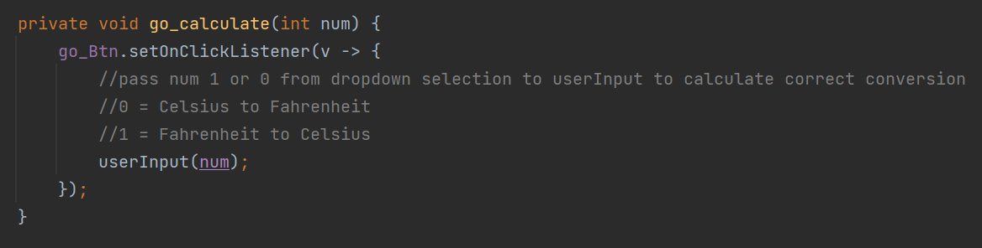
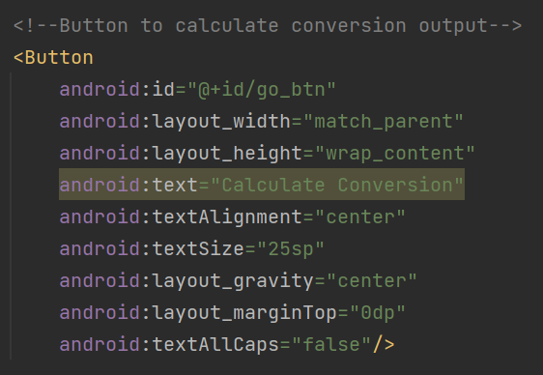
Conversion Button Code

Slide 12
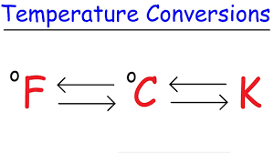
ConversionClass Implementation
The ConversionClass java class is the place where all the application’s conversion calculation is done.
This is where all the formulas for temperature conversions between Fahrenheit, Celsius, and Kelvin are stored and called upon.
There is a total of 6 different methods stored within ConversionClass, one for each type of conversion.
Notes:
Implemented by Andre
Kelvin added by Ellie

Slide 13
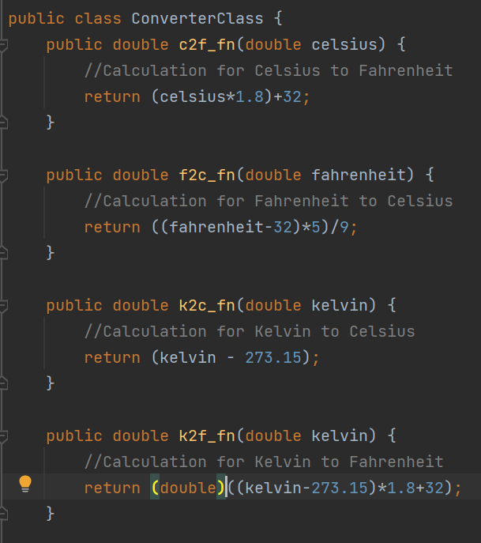
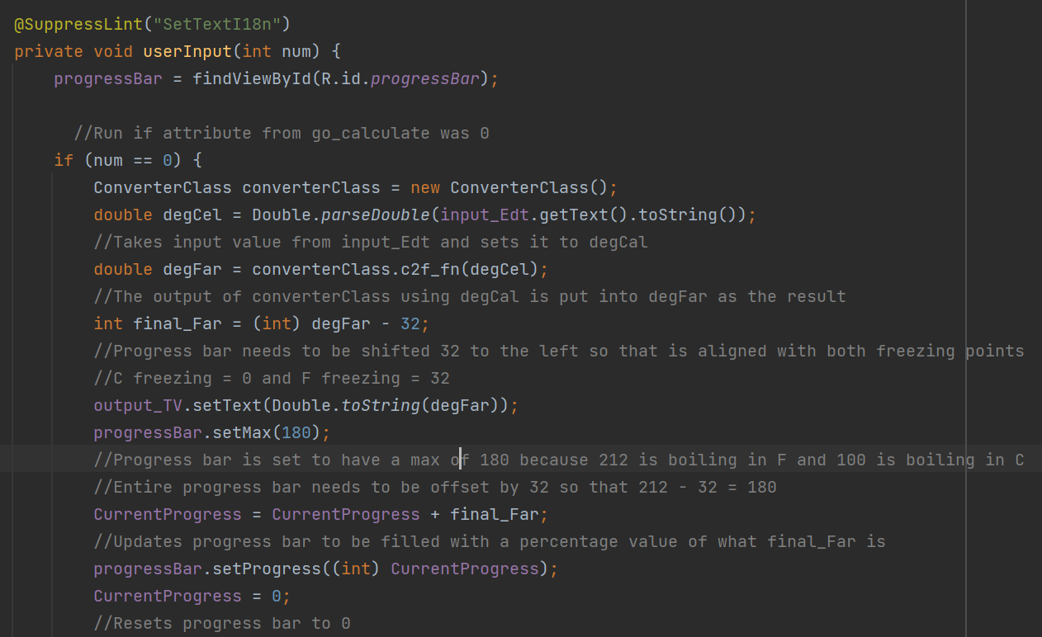
ConversionClass Code

Slide 14
Background Color Change Implementation
In order to give some drastic visual changes we implemented a background change depending on what the resulting conversion number is.
A range of between freezing and boiling for each conversion was set up which housed the color change code.
Notes:
Implemented by Andre with help from Ellie
Ellie updated colors to use hex values

Slide 15
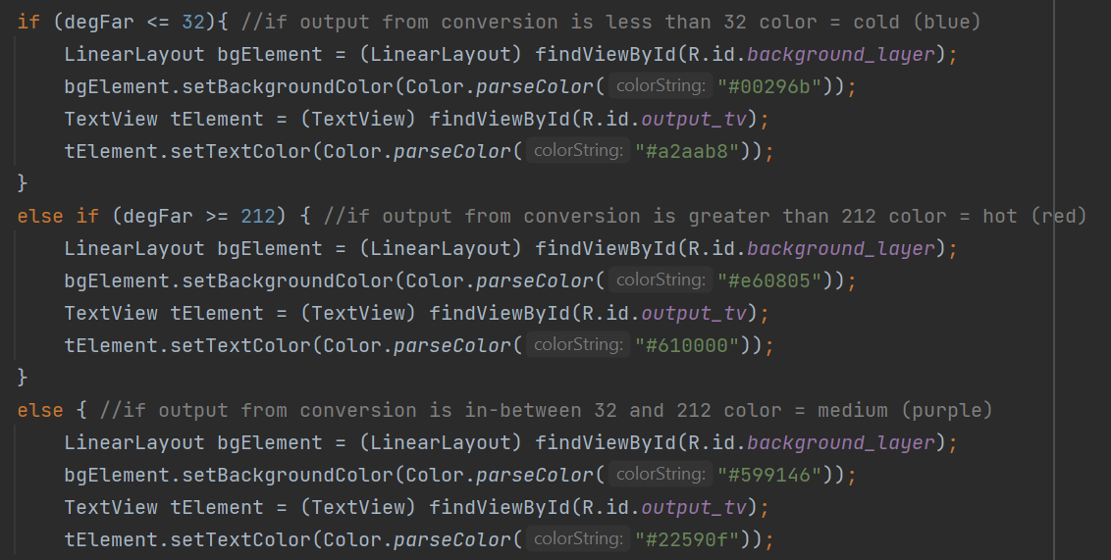
Background Color Change Code

Slide 16
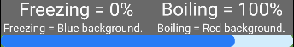
ProgressBar Implementation
Using a simple progress bar we were able to create a visual display of how close the resulting conversion number is to either the freezing or boiling points.
When the resulting conversion number is calculated, that number is passed onto the progress bar and updated depending on which conversion was selected.
Ex. F freezing = 32 so the bar needs to reflect that 0% = 32.
Notes:
Implemented by Ellie

Slide 17
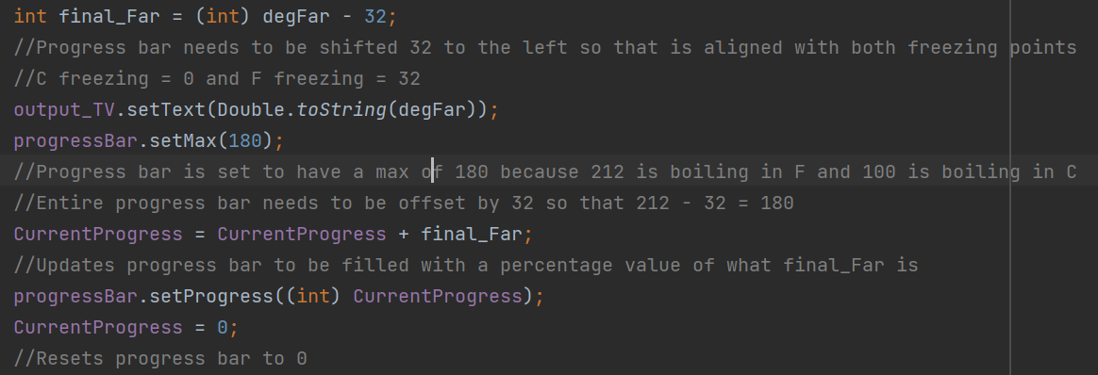
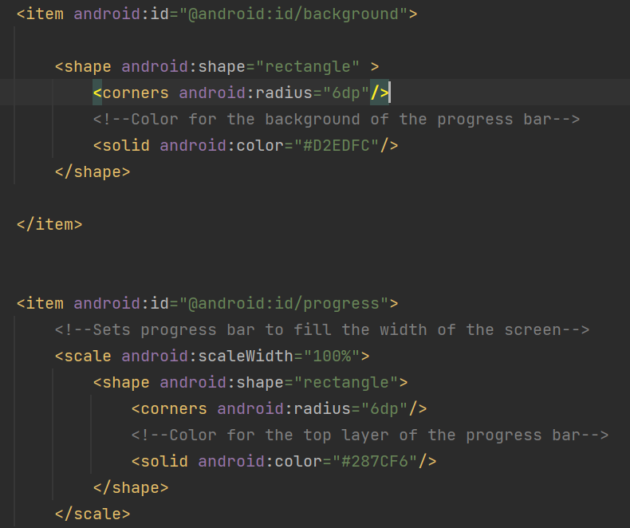
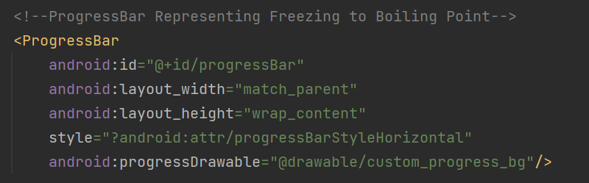
ProgressBar Code

Slide 18

Test Cases –Celsius to Fahrenheit
Input 40 and convert from Celsius to Fahrenheit; result will be 104.0.
Progress bar will be filled about one-third of the way and background will change to green.
Input -100 and convert from Celsius to Fahrenheit; result will be -148.0.
Progress bar will be empty, and background will change to blue.
Input 100 and convert from Celsius to Fahrenheit; result will be 212.0.
Progress bar will be full, and background will change to red.
Input 0 and convert from Celsius to Fahrenheit; result will be 32.
Progress bar will be empty, and background will change to blue.

Slide 19
Test Cases – Fahrenheit to Celsius
Input 32 and covert from Fahrenheit to Celsius; result will be 0.0.
Progress bar will be empty, and background will change to blue.
Input 212 and convert from Fahrenheit to Celsius; result will be 100.0.
Progress bar will be full, and background will change to red.
Input 175 and convert from Fahrenheit to Celsius; result will be 79.4 repeating.
Progress bar will be 80% full and background will change to green.
Input -32 and convert from Fahrenheit to Celsius; result will be -35.5 repeating.
Progress bar will be empty, and background will change to blue.

Slide 20
Test Cases – Kelvin to Celsius
Input 373.15 and convert from Kelvin to Celsius; result will be 100.0.
Progress bar will be 100% full and background will change to red.
Input 273.15 and convert from Kelvin to Celsius; result will be 0.0.
Progress bar will be empty, and background will change to blue.
Input 323.15 and convert from Kelvin to Celsius; result will be 50.0.
Progress bar will be 50% full and background will change to green.
Input -373.15 and convert from Kelvin to Celsius; result will be -646.30.
Progress bar will be empty, and background will change to blue.

Slide 21
Test Cases – Kelvin to Fahrenheit
Input 373.15 and convert from Kelvin to Fahrenheit result will be 212.0.
Progress bar will be full, and background will change to red.
Input 273.15 and convert from Kelvin to Fahrenheit; result will be 32.0.
Progress bar will be empty, and background will change to blue.
Input 323.15 and convert from Kelvin to Fahrenheit; result will be 122.0.
Progress bar will be 50% full and background will change to green.
Input -373.15 and convert from Kelvin to Fahrenheit; result will be -1131.34.
Progress bar will be empty, and background will change to blue.

Slide 22

Test Cases – Fahrenheit to Kelvin
Input 212 and convert from Fahrenheit to Kelvin; result will be 373.15.
Progress bar will be 100% full and background will change to red.
Input 32 and convert from Fahrenheit to Kelvin; result will be 273.15.
Progress bar will be empty, and background will change to blue.
Input 122 and convert from Fahrenheit to Kelvin; result will be 323.15.
Progress bar will be 50% full and background will change to green.
Input -212.00 and convert from Fahrenheit to Kelvin result will be 137.594444444444443.
Progress bar will be empty, and background will change to blue.

Slide 23
Test Cases – Celsius to Kelvin
Input 100 and convert from Celsius to Kelvin; result will be 373.15.
Progress bar will be 100% full and background will change to red.
Input 0 and convert from Celsius to Kelvin; result will be 273.15.
Progress bar will be empty, and background will change to blue.
Input 50 and convert from Celsius to Kelvin; result will be 323.15.
Progress bar will be 50% full and background will change to green.
Input -373.15 and convert from Celsius to Kelvin; result will be -100.0.
Progress bar will be empty, and background will change to blue.

Slide 24
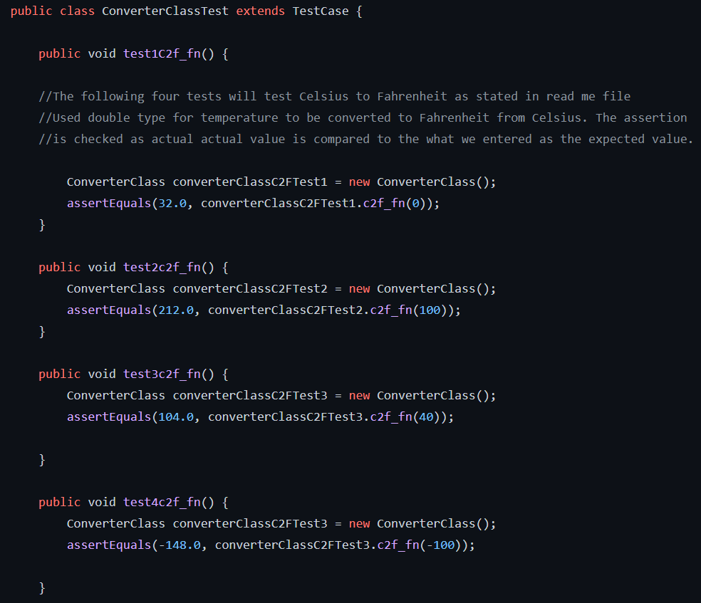
Test Case Code Example
Notes:
Implemented by Andre

Slide 25

Live Demonstration

